Slide 1
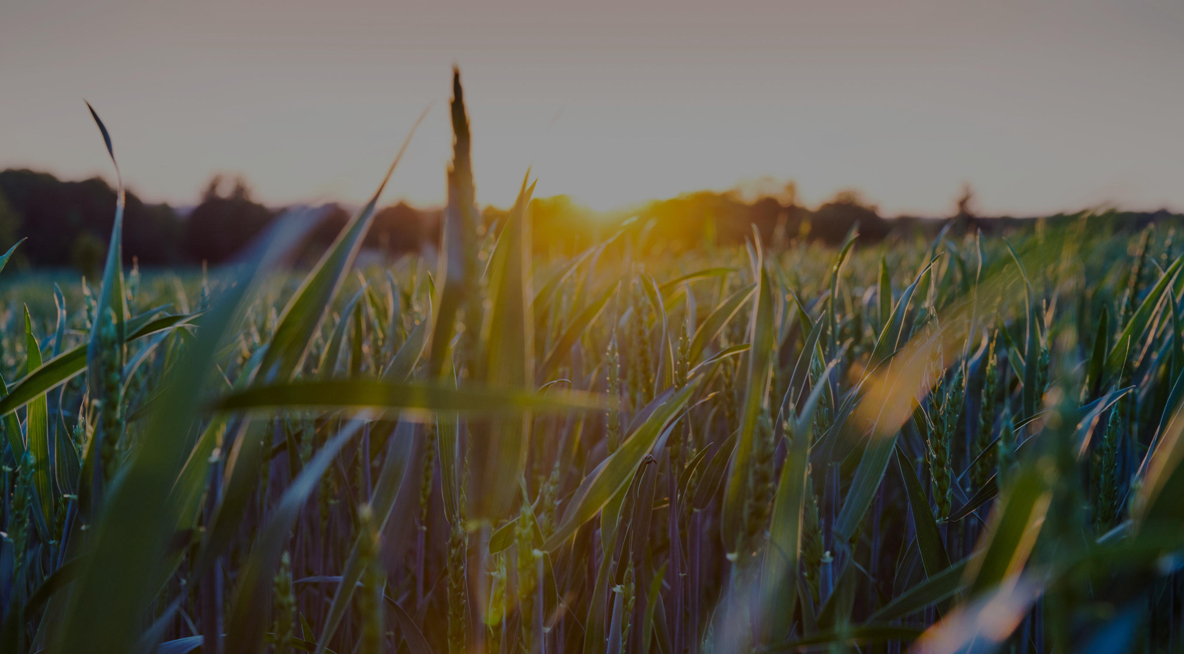
COFFEE
LAND
From Leaves to Roast
AI Knows Coffee Best

Slide 2



Coffee Land Team
Sara Alsadoun
Salwa Bukhari ​
Abdulrahman Ghazwani ​
Mussab Al-bargi ​
Azzam Garwan

Slide 3
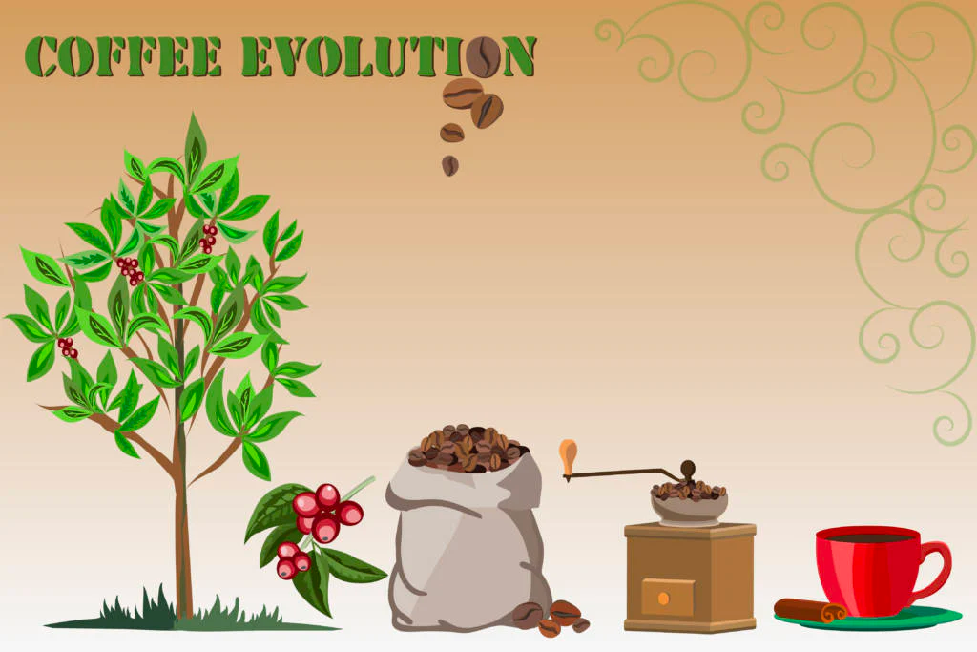
The Life Cycle of Coffee Plant

Slide 4


Vision 2030
The AI solution for coffee farming enhances the income of Saudi coffee farmers,elevates the country's global standing in the coffee market, and creates a unique Saudi coffee identity.
Aligned with Vision 2030, it contributes to economic diversification and sustainable development,
supporting Saudi Arabia's vision for a prosperous future.
Prosperous Economy
Saudi Arabian Identity

Slide 5
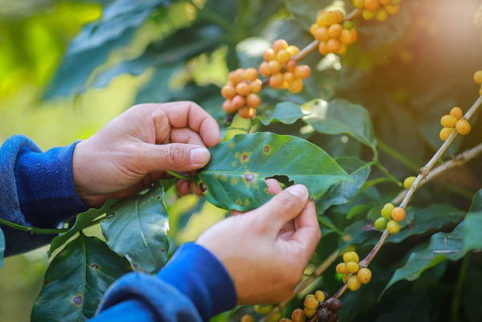
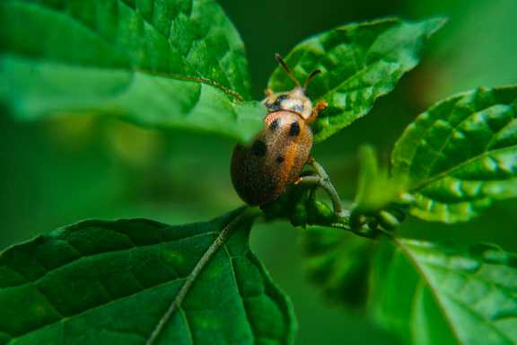
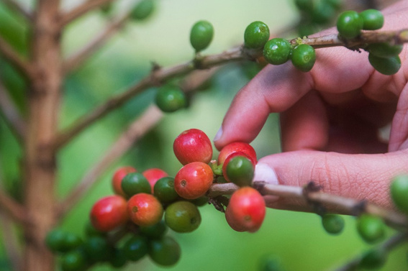
Problem
01
Coffee Leaf Diseases
Pests
02
03
Coffee Fruit

Slide 6


Our AI Solution
Steakholders
01
Pests Detection
The system keeps an eye out for pests and helps farmers
stop them from spreading diseases.
Companies
Audience
02
Coffee Leaf Diseases
Our AI quickly finds and alerts farmers about diseases in their
coffee plants with suggested results.
Farmers
03
Coffee Fruit Maturity
It predicts the perfect time to harvest, so beans do not dry out.
04
Coffee Bean Roast
Get advice on roasting coffee beans just right for the best taste.

Slide 7
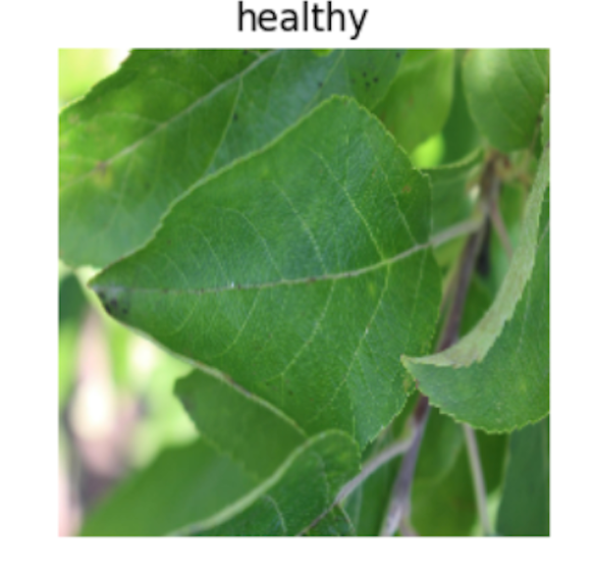
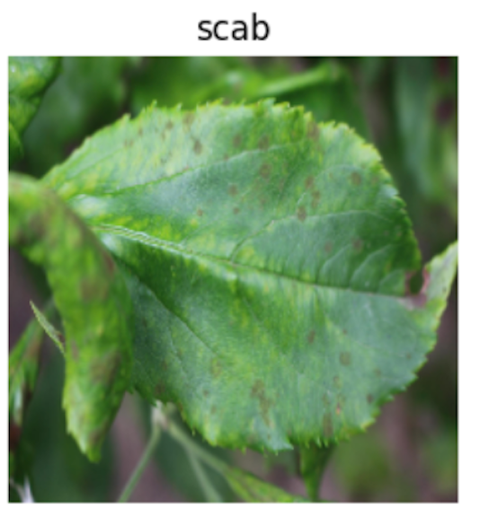
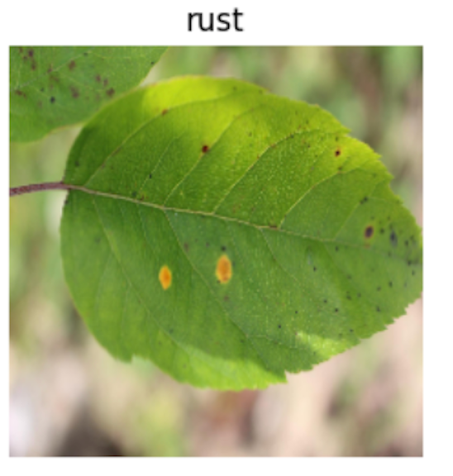
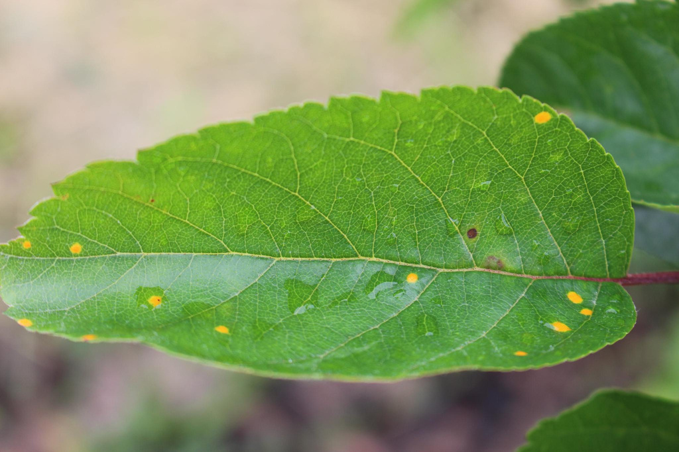
Coffee Leaf Diseases
Healthy
Scab
Rust
Multiple Diseases

Slide 8
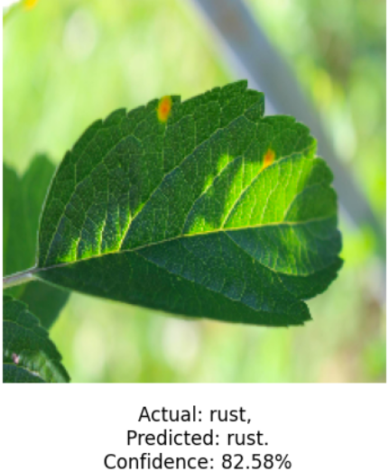
Coffee Leaf Diseases Model
Challenges:
Imbalanced Classes
Large Images
Small Dataset
Accuracy | 90%
Methods to Enhance Accuracy:
Data Augmentation
Transfer Learning
HyperParameter Tuning
Pre-trained Model Used:
MobileNet
EfficientNet
InceptionV3

Slide 9
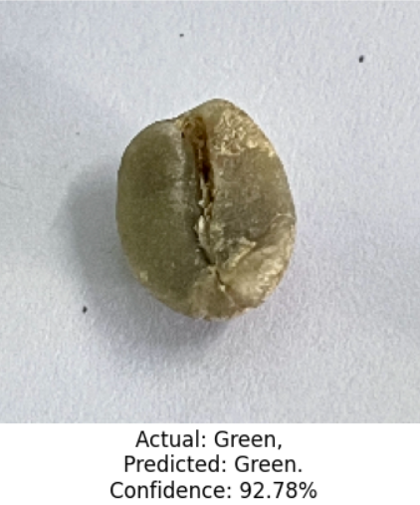
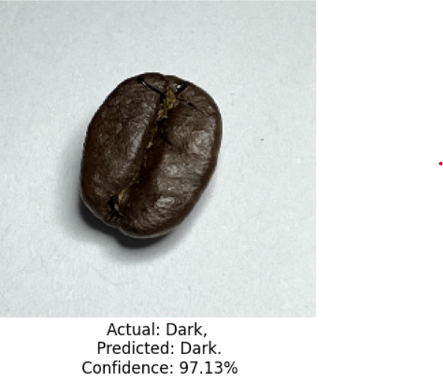
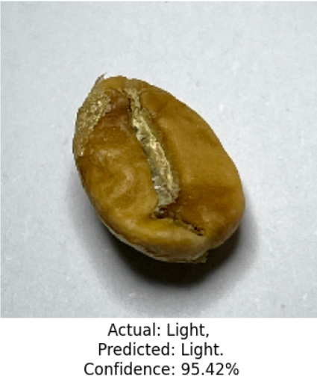
Coffee Beans Roast Model
Accuracy | 95%

Slide 10
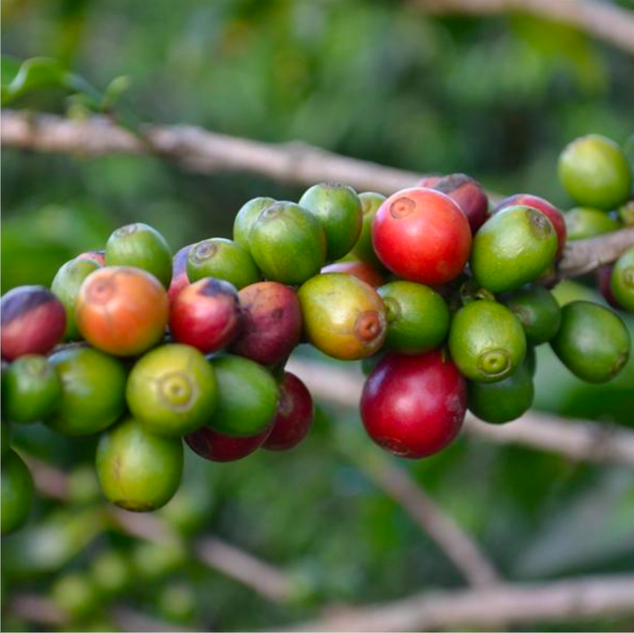
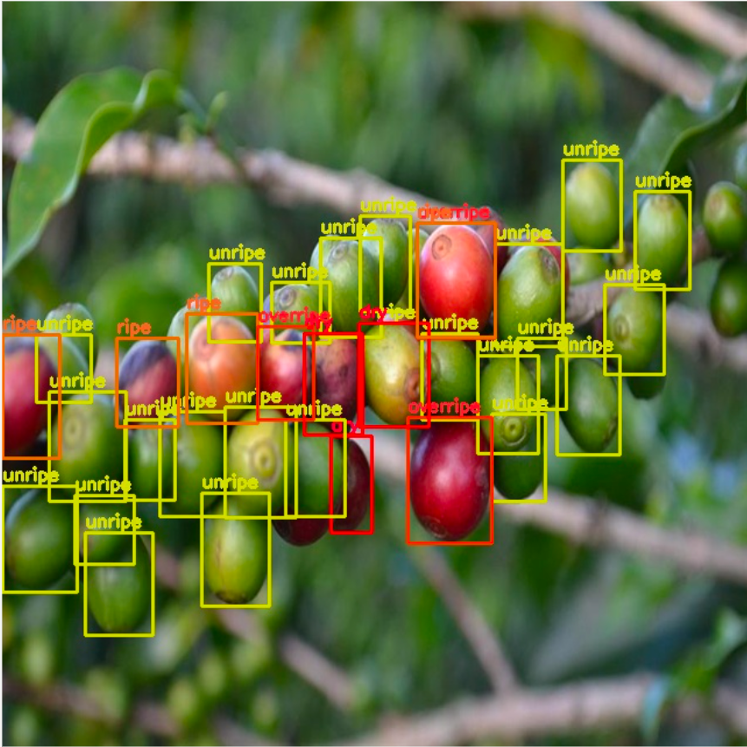
Coffee Fruit Maturity
Input
Output

Slide 11
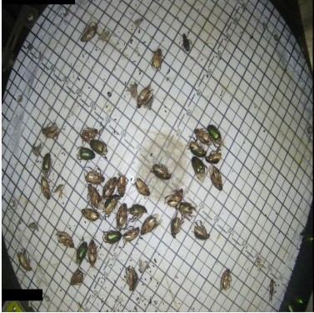
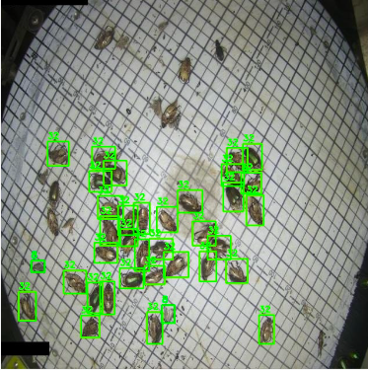
Pests Detection
Input
Output

Slide 12
Evaluation Metrics for Object Detection Models
Model Name | Accuracy (mAP50-95)
Coffee Fruit | 65%
Pests Detection | 39%

Slide 13
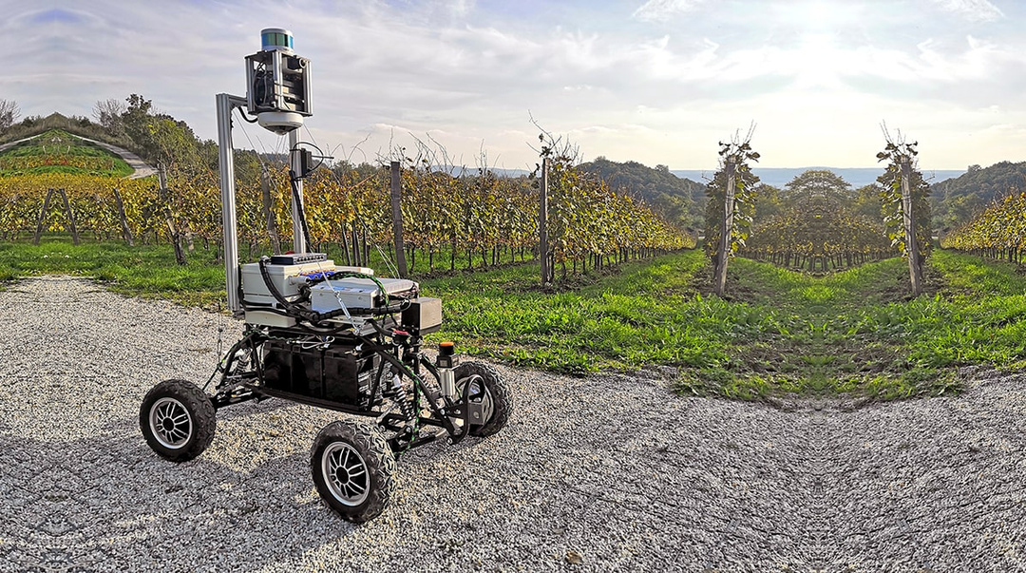
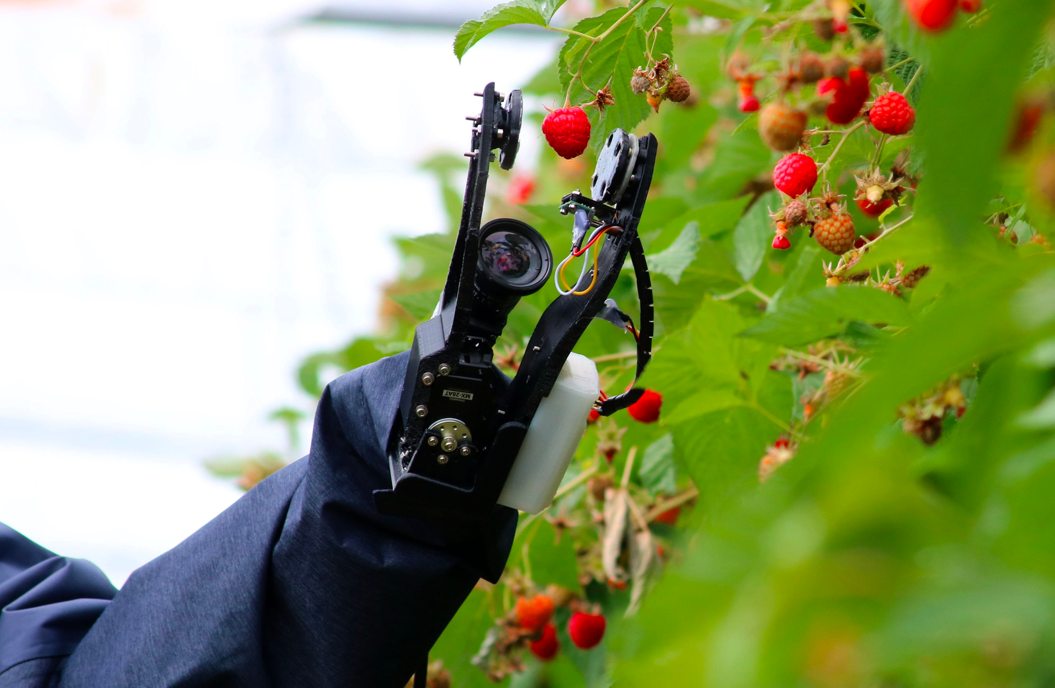
Future Work

Slide 14
Thank You
For Your Attention

Slide 15
